Slide 1
Sound Energy
Samuel DuPont 2009
Can you hear it?

Slide 2

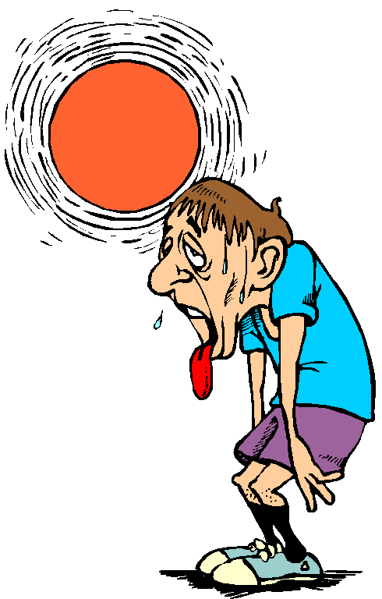
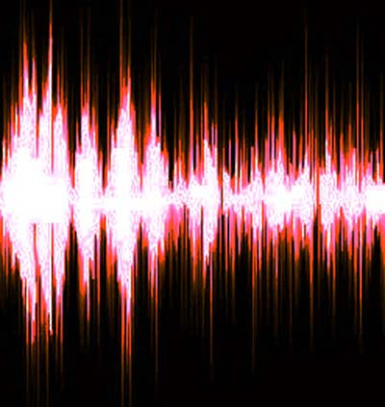
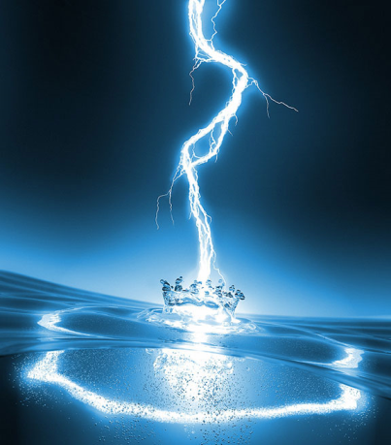
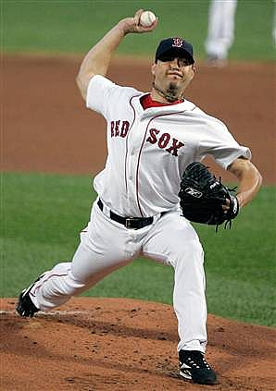
Review – 5 Forms of Energy?
Samuel DuPont 2009
Light
Heat
Sound
Electrical
Motion

Slide 3
What is Sound?
Samuel DuPont 2009
Sound is caused by motion of air
  Vibrations
The air moves in waves
  Sound Waves
Similar to “Energy of Motion”
  Moving air

Slide 4
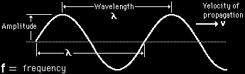
Vibrations and Pitch
Samuel DuPont 2009
A Sound Wave
  Length of the Wave (Wavelength)
    Pitch
  Amplitude
    How loud it is

Slide 5
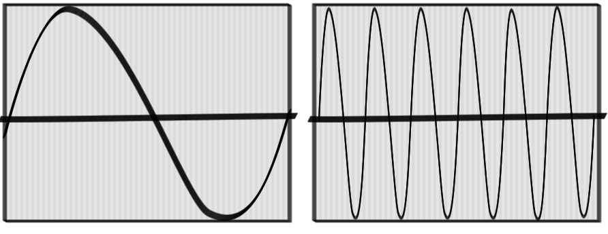
Vibrations and Pitch
Samuel DuPont 2009
Wavelength determines Pitch
Low Pitch (Bass)
High Pitch (Treble)

Slide 6
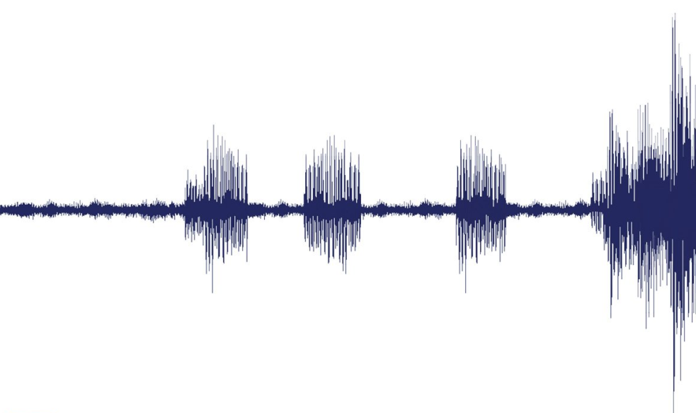
When we combine all the sounds together…
Samuel DuPont 2009
We get a full sound wave

Slide 7
How do we make sound?
Samuel DuPont 2009
We make Vibrations
  Smack our hands together
  Hit the desk

Slide 8
Lets Experiment!
Samuel DuPont 2009
Vibrating Rulers
  Shorter makes higher pitch
Rubber bands
  Stretching makes higher pitch
Acoustic Guitar

